Slide 1
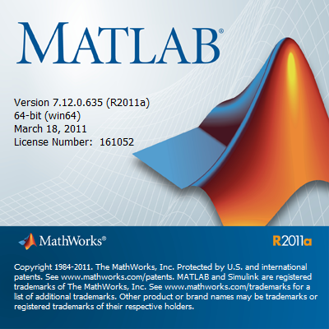

MATLAB Workshop:
DIY Examples
Jesse Knight
Oct 02 2016
revised: Nov 05 2017

Slide 2
Contents
What is MATLAB?
Getting Started
Review of Getting Started
DIY Examples:
Gas Equation
Coin Toss Live Plot
Fibonacci numbers
Discovering π

Slide 3
Review: What is MATLAB?
MATLAB is…
an “integrated development environment”
used for: - exploring data on the fly
- modeling systems (engines, maps, images, …)
- building research tools
used by: - engineers
- scientists
more powerful than Excel
but easier than programming in C

Slide 4
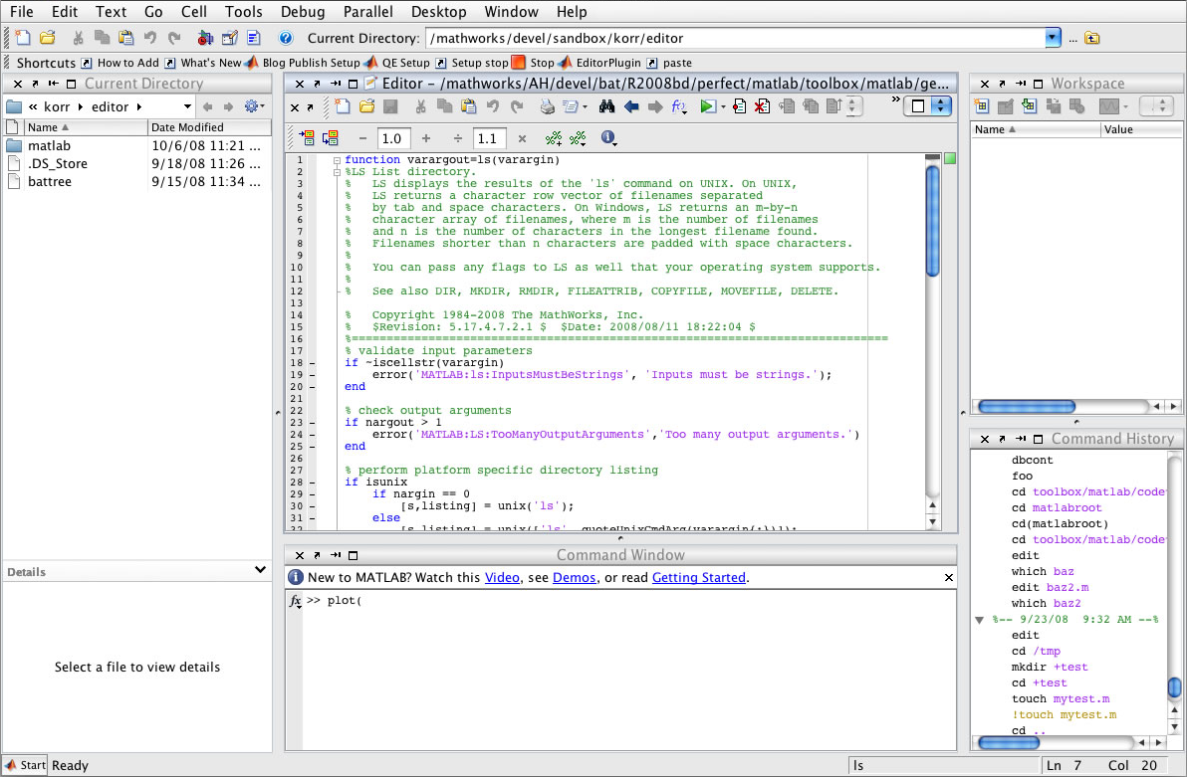
Review: Getting Started
WORKING DIRECTORY:
which files MATLAB can “see” at the moment
EDITOR:
create and edit code files
(scripts or functions)
WORK-SPACE:
your current variables
COMMAND HISTORY:
what you previously typed in the command window
COMMAND WINDOW:
write code on the fly
run code files

Slide 5
Review: Resources
Getting Started
Tutorial: MathWorks Getting Started Guide
Basic Syntax: Reference Card, example .m files
Specific Tasks: Google “ (doing X) in MATLAB ”
Debugging
“ help <function> ”
Guide to error messages
StackOverflow
Google
Peers, TAs, Profs

Slide 6
Review: Getting Started

Slide 7


Example: Gas Equation
An arbitrary sine function:
Values for $M$ and $t$:
$t=0 …5$ ($Δt=0.01$)
$M=[1,2,4]$
For each $M$, and constant $φ=\frac{π}{2}$, plot the value of $S(t)$.
Label axes appropriately.
$$S=M\sin{(2πt+φ)}$$

Slide 8
Example: Coin Toss Live Plot
Create a script which models 2000 coin tosses
Plot the running proportion of heads for tosses t = 1:2000
Edit the script to so that 10 tosses are plotted at a time, with a small delay between each update
Some useful functions might be:
round, rand, mod, drawnow, pause

Slide 9
Example: Fibonacci Numbers
Create a function to check if a number is a Fibonnacci number
Check the numbers n=1:10000 and show the result graphically
Hint: How are you going to check if a number is a Fibonacci number?
Some useful functions might be:
sqrt, round, if, else

Slide 10
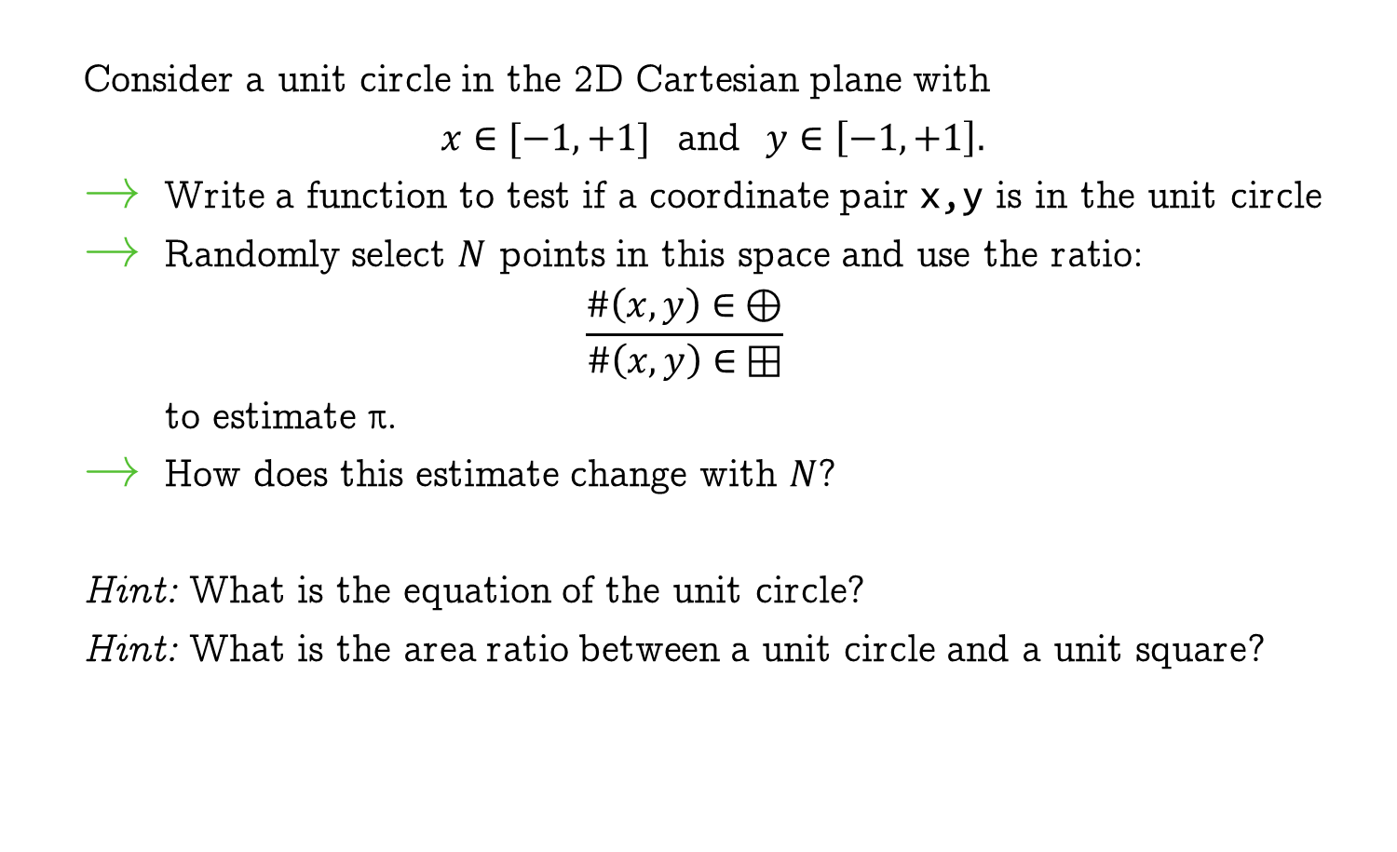
Example: Discovering π
Consider a unit circle in the 2D Cartesian plane with
$x∈[−1,+1]$ and $y∈\left[−1,+1\right].$
Write a function to test if a coordinate pair x,y is in the unit circle
Randomly select $N$ points in this space and use the ratio:
$$\frac{\#\left(x,y\right)∈ ⊕}{\#\left(x,y\right)∈ ⊞}$$
to estimate π.
How does this estimate change with $N$?
Hint: What is the equation of the unit circle?
Hint: What is the area ratio between a unit circle and a unit square?

Slide 11
References
The examples in this tutorial were inspired by
MATLAB for the Absolute Beginner
by Arvind Ravichandran.

